Slide 1
Ways forward for Adult ADHD Services
Facilitated by Alexia Mitton
Assistant Director of Engagement

Slide 2
Agenda
Item No. | Subject
1. | Welcome, Introductions, Apologies and Declarations of Interest
2. | Background
3. | Standards– how we will score options
4. | Scoring – assessing the possible ways forward against the standards using the evidence pack
5. | Introduction to the possible ways forward – “Options Appraisal” process setting out how this session will work this section will include scoring at each option
6. | Weighting of standards – we will show how we aim to work out the weighting of standards
7. | Next steps - Close meeting

Slide 3
Welcome, Introductions, Apologies and Declarations of Interest
Notes:
Introduction:
Welcome participants.
Outline the meeting’s purpose and objectives.
Introduce the facilitator and note-taker.
Identify any declarations, explain what may be considered as an interest i.e working for NHS, a patient etc.

Slide 4
Why are we here?
In this session we will take time to review the options proposed
We will do this by reviewing each option through discussions, looking at evidence and scoring each option against the gateway and evaluation standards
By the end of the meeting, we will have agreed the options that we will recommend go forward to the consultation phase.
The session will be facilitated by Alexia Mitton

Slide 5
Background
Notes:
Review of Objectives and Criteria:
Objectives:
Reiterate the project’s objectives.
Criteria:
Review the criteria and weighting used for the options appraisal.
Ensure all participants understand the scoring system and the rationale behind it.

Slide 6
Our journey so far:
Since 2019 referrals to adult ADHD services have grown by 500% with roughly 1500 monthly referrals being received in GM
Services are struggling to meet demand and support those who need support the most.
In 2023 a professional's task and finish group was set up to look at this
In late 2023 conversations started to look at how services may need to be delivered differently.
Feb 2024 a “why do things need to change” paper was written and following this pre consultation engagement was started

Slide 7
Case for change summary
​Since the pandemic, the number of people who have been referred for ADHD assessment, diagnosis and treatment has increased a lot:
​Adult AHD referrals are approximately 5 times higher than they were.
​​Currently, we estimate that there are approximately 60,000 adults with ADHD.
​​The situation is similar across the country and many places are reviewing their services.
​If we continue with the service as it currently is, some people could be waiting over 7 years for diagnosis and treatment, which is not acceptable to them or to us.

Slide 8
Standards

Slide 9
Gateway Standards
Evaluation Standards
Deliverability.
Offer of support for all.
Meets NICE guidelines.
Reduces Health inequalities.
Equity across GM.
Affordability.
Safety (includes Patients and Staff).
In the case of the above standards, all options will be looked at to decide whether they meet these standards, we will score these using a 1-5 scale. Standard 1 needs to receive a yes (5) with 2 and 3 achieving a minimum score of 3 to move on to be scored against evaluation standards
Note: All 3 standards must be met to proceed
In the case of the above standards, we will apply a weighting, this is a score given against each option to allow us to reach a decision on options that move through the gateway standards process.

Slide 10
Scoring against Standards
Notes:
Individual Scoring:
Have participants individually score each option based on the predefined criteria.
Group Discussion:
Discuss individual scores and rationales.
Identify any significant discrepancies and address them through discussion.
Consensus Building:
Work towards a consensus on the scores and ranking of each option.

Slide 11
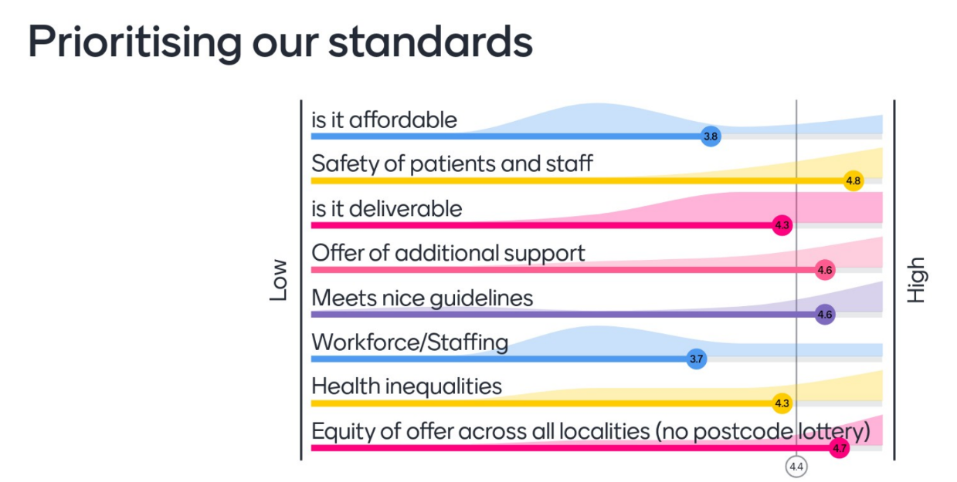
Notes:
Deliverability and Workforce were added together, and the score averaged to give a 4 this will be used to score against

Slide 12
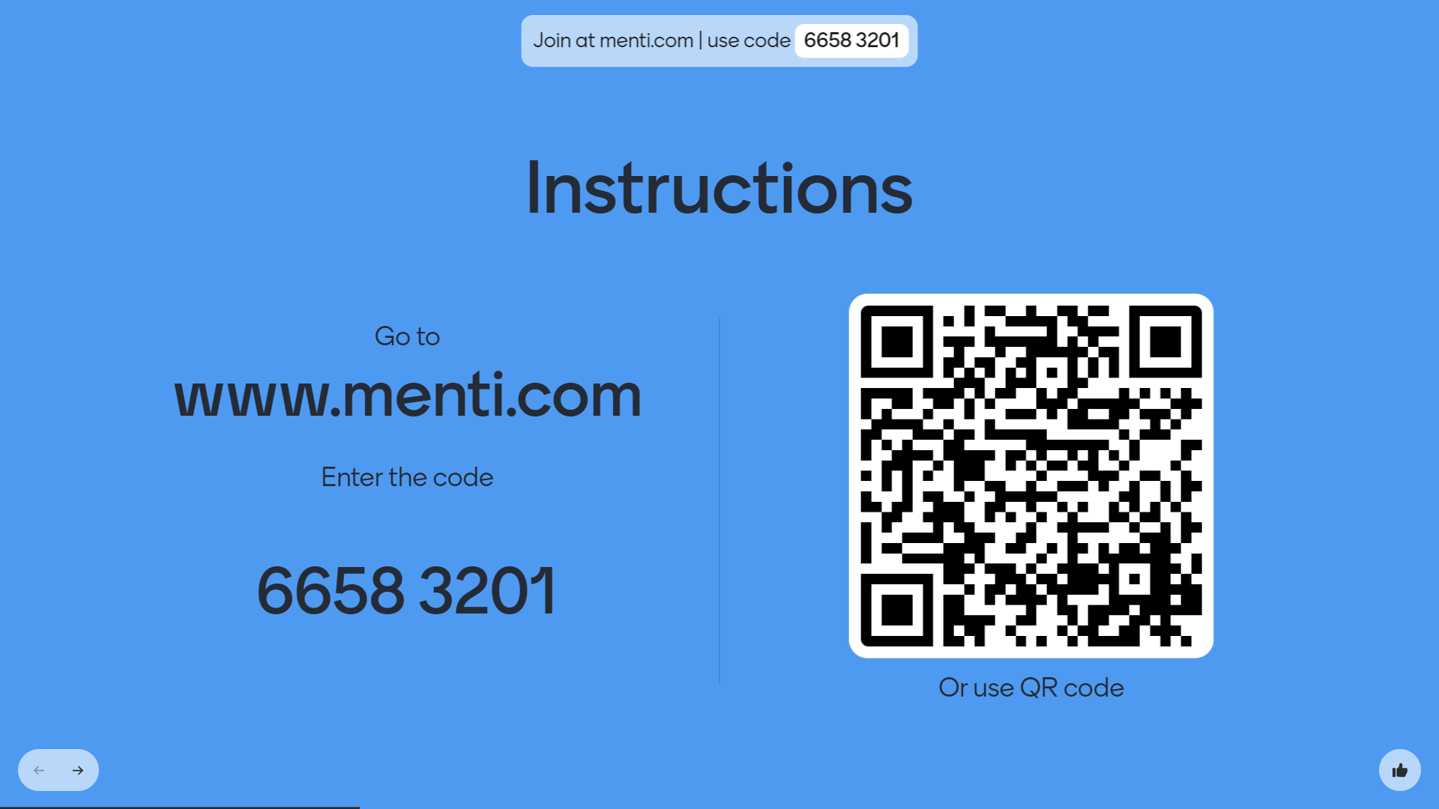

Slide 13
Ways Forward - The Options
Notes:
Summary of Each Option:
Provide a concise summary of each option being considered.
Highlight key features, benefits, risks, and costs.
Supporting Data:
Present any data, research, or analysis that supports the evaluation of each option.

Slide 14
Option 1: No change to the service which currently exists.
This option means we would continue to accept that many more people need the service than it could possibly ever support and assessments would continue to be offered to all.
Pros: | Cons:
Everyone who put themselves forward for an assessment would eventually have one. | This model has no way of prioritising based on need. The waiting time will continue to get longer as more and more people join the waiting list. The long waiting times for ADHD assessments could lead to safety risks for patients waiting. The current service does not meet the NICE guidelines. A potential drop in the service quality as the waiting times get longer. Unequal services across Greater Manchester with some people not having access to an NHS offer. More people relying on private services to get support. Potential media scrutiny and controversy. There is no way of controlling the escalating costs associated with this model.

Slide 15


Slide 16
Option 2: Clinical triage: Introducing a clinical threshold, with all patients triaged and prioritised based on their clinical need, and only those who meet the threshold receiving a service and going forward for diagnosis.
This option is about introducing referral criteria for people who will go on to receive support and diagnosis. Many services in the NHS have referral criteria to make sure that the people who need the service most get help in a timely manner. This means that everyone who gets referred by a GP to the service will be triaged by a clinical professional. This triage would be done with patients, and would not be expected to be a paper-based exercise. Only those who meet the clinical referral criteria will go forward for diagnosis and support. Based on other places where this has been implemented, we estimate that about 20-30% of people currently referred would go forward for diagnosis and support. Everyone else would be discharged from the service with no further offer of support.
Pros: | Cons:
Prioritisation of those in greatest clinical need and who need the service most. Meeting NICE guidelines and improved service quality. Safer service with those who urgently need help getting it. Lower waiting times and reduced risks associated with unmanaged demand. Cheaper service once everyone on the waiting list has been triaged. Equal offer for people across Greater Manchester with everyone having access to an NHS triage. | This process would take some time to achieve. The threshold will reduce the number of people who go forward for a potential diagnosis. No support provided for the 70-80% of patients who don’t meet the threshold. Some people who do not meet the threshold following triage may go on to use a private service. Potential media scrutiny and controversy. For those who meet the criteria, different localities will have different providers in place to deliver the assessment and diagnosis service (or the patient would have Right to Choose)

Slide 17
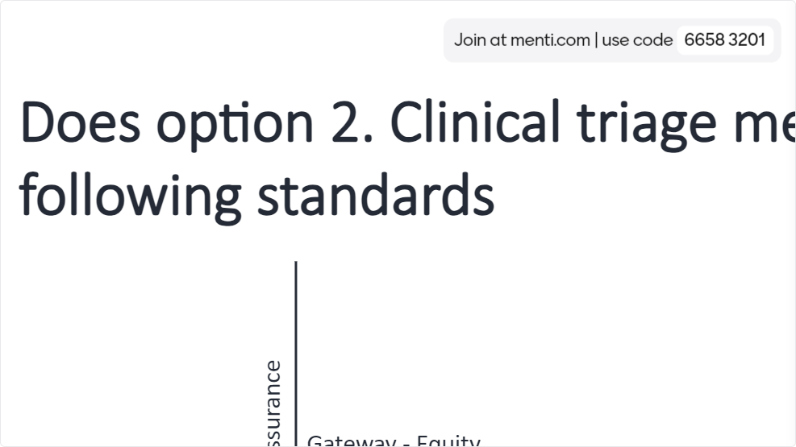

Slide 19
Option 3: Clinical triage with wider support offer:
Introducing a clinical threshold, with all patients triaged and prioritised based on their clinical need. Patients who don’t meet the threshold will get offered support to manage symptoms. Patients who meet the threshold will go forward for diagnosis.
Like the option above, this option is about introducing referral criteria for people who will go on to receive diagnosis. However, in this option, the people who do not meet the clinical referral criteria would be offered a more general offer of support to help with the management of any symptoms, including self-help tools.
Pros: | Cons:
Prioritisation of those in greatest clinical need and who need the service most. Support offered to everyone. Meeting NICE guidelines and improved service quality. Safer service with those who urgently need help getting it. Lower waiting times and reduced risks associated with unmanaged demand. Equal offer for people across Greater Manchester with everyone having access to an NHS triage. | This process would take some time to achieve. The threshold will reduce the number of people who go forward for a potential diagnosis. The wider support offer will cost money, so this option will be more expensive than option 2. Some people who do not meet the threshold following triage may go on to use a private service. People may choose not to use the support on offer. Potential media scrutiny and controversy. For those who meet the criteria, different localities will have different providers in place to deliver the assessment and diagnosis service (or the patient would have Right to Choose)

Slide 20


Slide 21
Option 4: Universal offer, followed by clinical triage: Provide everyone who comes forward with an offer of support to help manage symptoms. Patients who then request further support will be triaged against a clinical threshold and prioritised based on their clinical lead, with those who meet the threshold going forward for diagnosis.
This change is very similar to option 3, but the other way around. All those who come forward are able to receive self-help support without delay. If this support doesn’t help a patient, they would then go forward for triaging against the clinical referral criteria. If they meet the threshold, they will go on for diagnosis and further support.
Pros: | Cons:
Fast support offered to everyone. Prioritisation of those in greatest clinical need and who need the service most, although only after trying the initial support offer. Meeting NICE guidelines and improved service quality. This could have a positive impact on reducing the size and scale of the waiting list, as some individuals may have got what they need purely from the universal offer of support without proceeding through to assessment for diagnosis. Equal offer for people across Greater Manchester with everyone having access to an NHS triage. | This process would take some time to achieve. This process could make the journey to accessing diagnosis a longer one, therefore increasing risk associated with those who need higher levels of support more quickly. This option will be more expensive than option 3 as everyone will access the general, universal offer of support first, before prioritisation. A small number of people may not want to use the support offer and push for the next stage. Some people who do not meet the threshold following triage may go on to use a private service. Potential media scrutiny and controversy. For those who meet the criteria, different localities will have different providers in place to deliver the assessment and diagnosis service (or the patient would have Right to Choose)

Slide 22


Slide 23
Option 5: Online triage: Introduce a clinical threshold for patients to access the service, with patients using an online assessment tool which they do by themselves. Only those who meet the criteria will get support and diagnosis.
This option came through the engagement exercise. It is currently used in at least one other place in the country. Like option 2, this option is about introducing clinical referral criteria for people who will go on to receive support and diagnosis. In this option, the triage will be an online self-assessment completed by the patient themselves. Only those who meet the clinical referral criteria will go forward for diagnosis and support. We again estimate that about 20-30% of people currently referred would go forward for diagnosis and support. Everyone else would be discharged from the service with no further offer of support.
Pros: | Cons:
Open to everyone who was interested to complete the assessment. An online assessment would be cheaper and require fewer staff. Prioritisation of those in greatest clinical need and who need the service most. Meeting NICE guidelines and improved service quality. Safer service with those who urgently need help getting it. Lower waiting times and reduced risks associated with unmanaged demand. | This option removes the person-centred approach with a medical professional and may allow people who urgently need help to slip through the gaps due to the fixed nature of an online assessment. It may increase the number of people being assessed due to ease and speed of getting an online assessment. This process would take some time to achieve. The threshold will reduce the number of people who go forward for a potential diagnosis. No support provided for the 70-80% of patients who don’t meet the threshold. Some people who do not meet the threshold following triage may go on to use a private service. Potential media scrutiny and controversy.

Slide 25
Option 6: Online triage with wider support offer: Introduce a clinical threshold for patients to access the service, with patients using an online assessment tool which they do by themselves. Patients who don’t meet the threshold will get offered support to manage symptoms. Patients who meet the threshold will go forward for diagnosis.
This option is very similar to option 5. However, in this option, the people who do not meet the threshold of the online assessment would be offered a more general offer of support to help with the management of any symptoms, including self-help tools (like option 3).
Pros: | Cons:
Open to everyone who was interested to complete the assessment. An online assessment would be cheaper and require fewer staff. Prioritisation of those in greatest clinical need and who need the service most. Meeting NICE guidelines and improved service quality. Support offered to everyone. Safer service with those who urgently need help getting it. Lower waiting times and reduced risks associated with unmanaged demand. | This option removes the person-centred approach with a medical professional and may allow people who urgently need help to slip through the gaps due to the fixed nature of an online assessment. It may increase the number of people being assessed due to ease and speed of getting an online assessment. This process would take some time to achieve. The threshold will reduce the number of people who go forward for a potential diagnosis. The wider support offer will cost money, so this option will be more expensive than option 5, but cheaper than option 3. Some people who do not meet the threshold following triage may go on to use a private service. People may choose not to use the support on offer. Potential media scrutiny and controversy.

Slide 26


Slide 27
Option 7: Fund a bigger service: Fund additional staff/teams to be able to clear the waiting list and offer diagnosis to everyone going forward.
This change would mean reallocating money from other health services to fund a service that assesses everyone who comes forward – regardless of need, in a timely manner.
Pros: | Cons:
All individuals who wanted access to an ADHD assessment in Greater Manchester would receive one. This would be safer than the current service with more timely access to support, but the waiting time could potentially still be longer than some of the other options. | This model would still act on a first come first served waiting list with no prioritisation of need. This would be an expensive option, and there isn’t the money to pay for the service without impacting on other services. This would need a lot more staff, which would not be readily available. This would take some time to achieve. The waiting list may outstrip the increased capacity over time, creating a similar problem to be solved.

Slide 28


Slide 29
Option 8: Stop the service: No longer fund adult ADHD services.
This would mean stopping offering ADHD services to adults completely. This option is unlikely to be a viable option, but is included for completeness.
Pros: | Cons:
This would remove the cost associated with providing adult ADHD services and staff to support other services. | This is likely to be unsafe as it could create a risk of harm for those who need ADHD services most. This does not follow NICE guidelines. Potential media scrutiny and controversy. People would be forced to use private, which means only those who can afford it are able to There would be no assurance over the quality of providers.

Slide 31
Discussion and feedback
Notes:
Open Floor for Discussion:
Allow participants to ask questions and seek clarifications.
Encourage open discussion about the pros and cons of each option.
Stakeholder Feedback:
Collect feedback and input from all key stakeholders.
Ensure all voices are heard, including any concerns or alternative viewpoints

Slide 32
Weighting of Evaluation Standards

Slide 33
Weighting of evaluation standards
Evaluation Standard | Prioritisation Score | Ratio to apply | Weighting
Deliverable | 4 | 5.71 | 22.8
Offer of support for all | 4.6 | 5.71 | 26.6
Nice Guidance | 4.6 | 5.71 | 26.3
Reduce Inequalities | 4.3 | 5.71 | 24.6
Total | 17.5 |  | 100
We took the total prioritisation score 17.5 and divided 100 by 17.5 to give us a ratio of 5.71. We then multiplied the score and the ratio to give us a weighting
Notes:
TBC

Slide 34
Options Table and Scoring
 | Option 1 |  |  | Option 2 |  |  | Option 3 |  |  | Option 4
 | Score | Weight | Total | Score | Weight | Total | Score | Weight | Total | Score | Weight | Total
Deliverable |  | 22.8 |  |  | 22.8 |  |  | 22.8 |  |  | 22.8
Offer of support for all |  | 26.3 |  |  | 26.3 |  |  | 26.3 |  |  | 26.3
Nice Guidance |  | 26.3 |  |  | 26.3 |  |  | 26.3 |  |  | 26.3
Reduce Inequalities |  | 24.6 |  |  | 24.6 |  |  | 24.6 |  |  | 24.6
Total |  | 100 |  |  | 100 |  |  | 100 |  |  | 100

Slide 35
Options Table and Scoring
 | Option 5 |  |  | Option 6 |  |  | Option 7 |  |  | Option 8
 | Score | Weight | Total | Score | Weight | Total | Score | Weight | Total | Score | Weight | Total
Deliverable |  | 22.8 |  |  | 22.8 |  |  | 22.8 |  |  | 22.8
Offer of support for all |  | 26.3 |  |  | 26.3 |  |  | 26.3 |  |  | 26.3
Nice Guidance |  | 26.3 |  |  | 26.3 |  |  | 26.3 |  |  | 26.3
Reduce Inequalities |  | 24.6 |  |  | 24.6 |  |  | 24.6 |  |  | 24.6
Total |  | 100 |  |  | 100 |  |  | 100 |  |  | 100

Slide 36
Next Steps
Notes:
Action Items:
Outline the immediate next steps, responsibilities, and timelines.
Communication Plan:
Plan how the decision and its rationale will be communicated to broader stakeholders.

Slide 37
Next Steps
NHS Greater Manchester's decision making body will be advised of the outcome they will make a decision of what options will go forward.
We will update all parties of the decision and a date that the consultation will go live
A lived experience group will be called prior to consultation starting to assist in the developments of plans.#
No consultation can begin until after the general Election has finished, we are currently in the pre-election period and aim to go to consultation from 8th July 2024

Slide 38
Closing Remarks
Notes:
Summary:
Summarize the key points, decisions, and agreed actions.
Thank Participants:
Thank all participants for their contributions.
Schedule Follow-Up:
Schedule any necessary follow-up meetings or check-ins.

