Slide 1
IVF Cycles Consultation
18th June – 29th July 2025
Presented by: Firstname Surname
Date: XX XXXX 2025

Slide 2
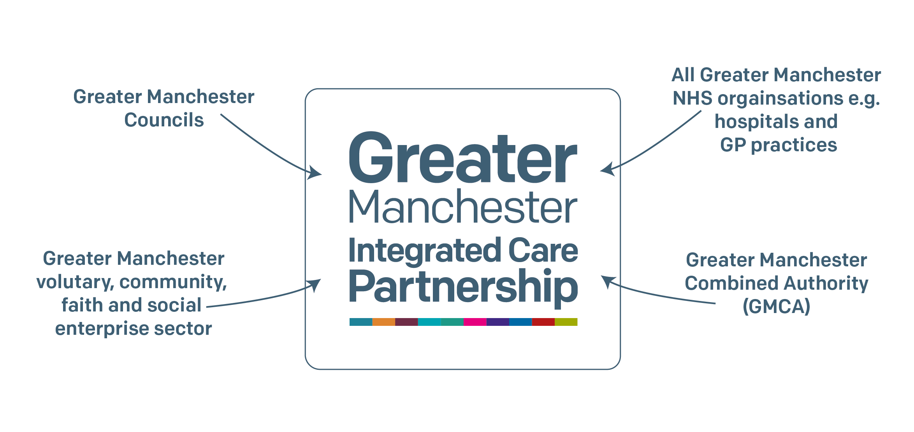
Who are we?
NHS Greater Manchester (GM) is one of 42 Integrated Care Boards (ICBs) in England. ICBs are NHS organisations responsible for planning and commissioning health services for the local population.
This means that we have the job of deciding what health services are needed for people who live in Greater Manchester, funding health services that meet those needs, and monitoring the quality of the services that are delivered.

Slide 3
What is IVF and why are we changing it?

Slide 4
IVF
IVF (In vitro fertilisation) is one of several techniques available to help people with fertility problems have a baby.
People who need IVF can get a number of tries on the NHS if they meet the criteria. Each try is known as a cycle.
A full cycle is different for everyone, but generally it includes 1 episode of ovarian stimulation and the transfer of any fresh and frozen embryo(s).

Slide 5
Why does a change need to happen?
The number of IVF cycles offered to women aged 39 and under across Greater Manchester is different depending on which locality their GP practice is in.
This means that women living only a few miles apart may be offered different numbers of cycles, from 1 cycle to 2 or 3 cycles.
Things are different across Greater Manchester because the number of cycles were agreed when there were ten different NHS organisations, known as Clinical Commissioning Groups, making the decisions about healthcare. In July 2022, these were replaced by one organisation known as NHS Greater Manchester.
We believe that the number of IVF cycles offered across Greater Manchester needs to be standardised so that the offer is fair and consistent.

Slide 6
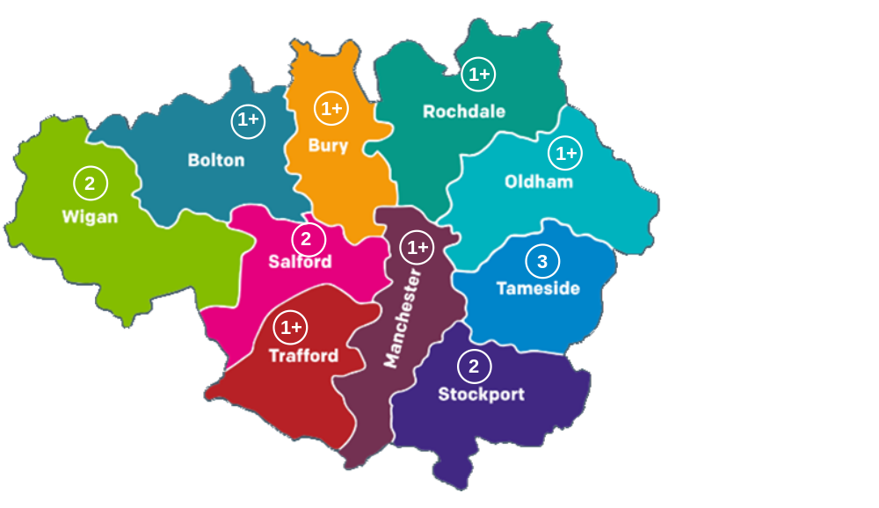
The number of NHS funded IVF cycles currently available across the different Greater Manchester localities
The GM picture
Notes:
At the moment, depending on where a person lives in Greater Manchester, they will get offered a different number of cycles – from 1 cycle to 3 cycles.
For eligible women aged 39 and under and couples, with a GP in these areas, the NHS will pay for:
Bolton, Bury, Rochdale, Manchester, Oldham and Trafford patients can get 1 cycle of IVF and receive a second try for a cancelled or abandoned cycles – we call this 1+.
Salford, Stockport and Wigan patients can get 2 IVF cycles (this includes cancelled or abandoned cycles).
Tameside patients can get 3 IVF cycles (this includes cancelled or abandoned cycles).
Women aged 40-42 are only eligible for 1 cycle regardless of where they live, based on NICE guidance.

Slide 7
Who will be affected by any change?
​​​There are nearly 500,000 (half a million) women aged 20-39 in Greater Manchester – ranging from 27,000 in Bury to 140,000 in Manchester.
​About 1,000 women aged 39 and under and couples currently access NHS funded IVF each year in Greater Manchester. This is about 0.2% of the women aged 20-39.
The cost is estimated at £2.6million.
Any changes to the number of cycles will only affect people aged 39 and under.
There is not going to be any change to the eligibility criteria.

Slide 8
What has been considered?
We considered a number of options for the future of IVF services:
Do nothing and continue with the postcode lottery
0 cycles
1 cycle (includes abandoned / cancelled cycle)
1 complete cycle plus a second attempt if first one is abandoned / cancelled (1+)
2 cycles (includes abandoned / cancelled cycles)
2 cycles plus a third attempt if at least one of the first two is abandoned / cancelled (2+)
3 cycles (includes abandoned / cancelled cycles)
More than 3 cycles (maybe full or abandoned / cancelled cycles)
Our preferred option
Notes:
These are the options which have been considered throughout the service change process. Each were placed against a set of criteria, which included affordability, comparable numbers to other ICB's and workforce.
Following this, our Board decided that we should go to a public consultation with one option... 1 complete cycle plus a second attempt if first one is abandoned / cancelled (1+).

Slide 9
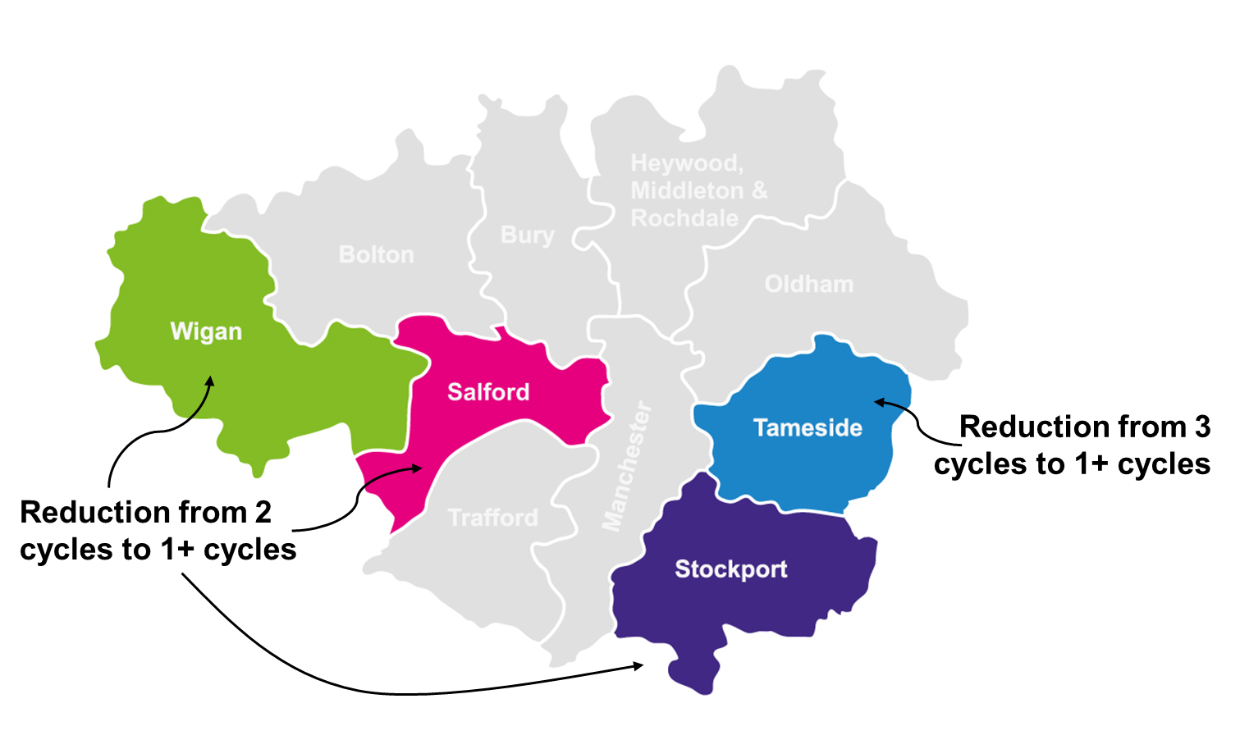
The new GM picture
How the number of NHS funded IVF cycles would change if the 1+ was introduced across Greater Manchester
Notes:
This means that for 6 of the localities in Greater Manchester, there would be no difference in the number of cycles that people have access to. This is the option that impacts the least number of people.
For people in Salford, Stockport and Wigan, they will go down from the current offer of 2 cycles as standard to 1 cycle, with a second one only available if the first is cancelled or abandoned.
For people in Tameside, they will go down from the current offer of 3 cycles, to 1 cycle, with a second one only available if the first is cancelled or abandoned.

Slide 10
The option: 1 cycle plus a second attempt if the first was cancelled or abandoned (1+)
This is considered the best option because:
It will create an equal offer across Greater Manchester
It is already the policy for most localities across GM
This will mean it impacts the fewest number of people
It is similar to offer across most of England, creating more equity across the country
It is affordable, does not require any additional funding which may need to be taken from another NHS service. This option is affordable for the future.

Slide 11
What do you think?

Slide 12
What we want your thoughts on
What do you think of the proposed option? What would be good about it and what might be challenging?
How can we implement this policy change fairly to those already on their IVF journey?
Is there any ways that this option might impact some people more than others?
Are there any other options which you think we should consider?

Slide 13





Thoughts on the proposal
Activity!
What do you think about the proposal to offer 1+ cycles to everyone across Greater Manchester?
Strongly disagree
Disagree
Neither agree nor disagree
Agree
Strongly agree

Slide 14
Thoughts on the proposal
Discussion!
What do you think that?
Consider…
What could be good about the proposal?
What could be bad about the proposal?

Slide 15








Applying any change fairly
Waiting to find out if they are approved for another cycle
Approved for the next cycle, but no start date
Scheduled for the next cycle but not started it yet
If a change is made, people will be at different stages in their journey from the point the new policy is approved. We think that everyone who has started a cycle should get to finish it, but apart from that, who should the new policy be applied to and why?

Slide 16
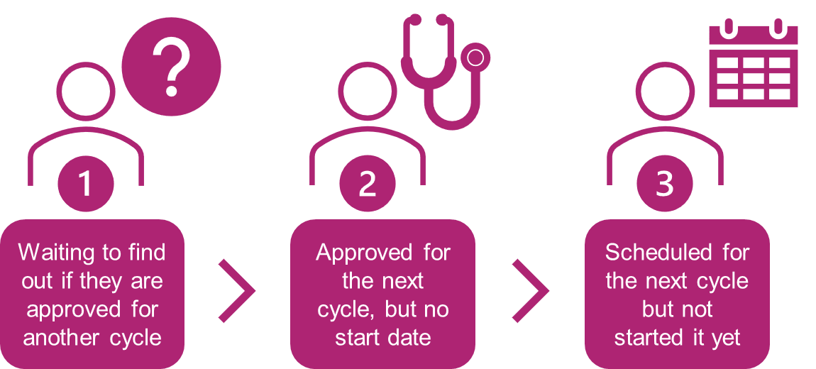
Applying any change fairly
Discussion!
Who do you think any new policy should be applied to?
Person (or couple) 1 only? People (or couples) 1 and 2? All of them? None of them?
Consider…
What is the fairest way to apply the policy?
What factors are influencing your decision/thinking?

Slide 17
Final thoughts
Discussion!
Is there anything else you think we should know or think about?
Consider…
Is there any reason these proposals might impact you, a person or community more than another?
Are there any other options you think we should consider that we haven’t?

Slide 18
Next steps

Slide 19
Next steps
After the consultation has closed, time will be taken to create a report
The report, alongside further evidence and a recommendation, will be taken through our governance process
NHS Greater Manchester Board will consider the views and suggestions before making a final decision on what the new offer will be, across Greater Manchester
Following this, the policy will be updated with the new number of cycles, and patients, GP’s and service providers will be informed.

Slide 20
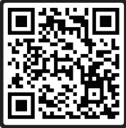
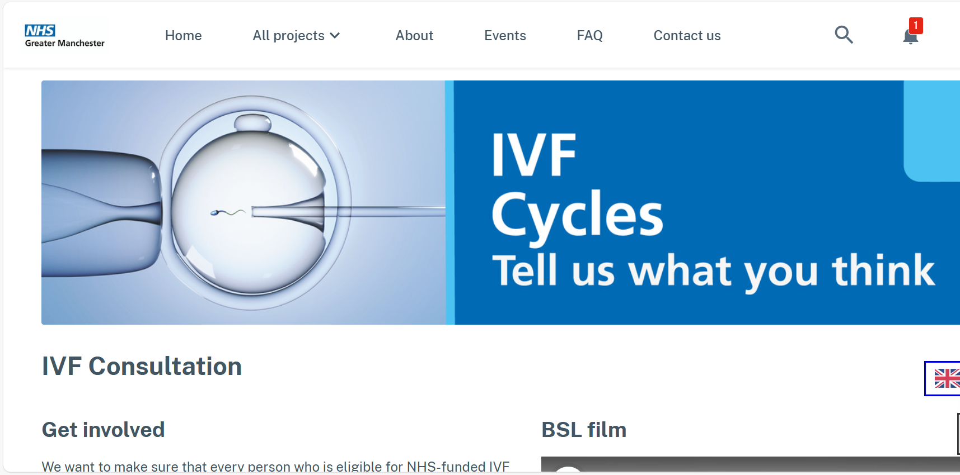
To find out more and get involved
Visit our website or scan the QR code
Send us an email gmhscp.engagement@nhs.net
Message or call us on 07786 673762

