Slide 1
Lived experience group meeting
Facilitated by Scott Williams and Amanda Rafferty
Engagement Team

Slide 2
Meeting Expectations.
This meeting is confidential all associated discussions and documents shared are not to be downloaded and shared.
It's important to us that this group is not recorded by members. NHS GM who will only record with consent and for the purpose of creating minutes at which point the recording and transcript will be deleted.
We will not use names as part of our minutes, your contributions will be anonymous unless previously discussed and agreed
To avoid AI bots we will ask that all attendees introduce themselves at the start of the meeting (this can be done via camera or via the chat function)

Slide 3
Welcome, Introductions, Apologies and Declarations of Interest
Notes:
Introduction:
Welcome participants.
Outline the meeting’s purpose and objectives.
Introduce the facilitator and note-taker.
Identify any declarations, explain what may be considered as an interest i.e working for NHS, a patient etc.

Slide 4
Agenda
Item No. | Timings | Subject
1. | 18:00 | Welcome, Introductions, Apologies and Declarations of Interest
2. | 18:05 | Consultation Doc introduction Amanda Rafferty, Head of Locality Engagement, NHS GM
3. | 18:15 | Consultation doc review Chris Pimlott, Head of MH Strategic Commissioning, NHS GM
4. | 18:40 | Discussions and Feedback
5. | 18:55 | Get involved Platform support offer Scott Williams, Engagement Manager, NHS GM
6. | 18:58 | Next steps – (See slide) – Information will be shared on our involvement platform Close meeting

Slide 5
Quick update
Notes:
Review of Objectives and Criteria:
Objectives:
Reiterate the project’s objectives.
Criteria:
Review the criteria and weighting used for the options appraisal.
Ensure all participants understand the scoring system and the rationale behind it.

Slide 6
Update
​Received approval from NHSE to progress to consultation
NHS GM Board, 26th March 2025 (originally 19th March)
Proposed consultation start date changed to 7th April 2025 (dependant on outcome from above)
Stakeholder briefings
8 weeks of consultation
4 weeks of evaluation
Results and decision ratified through governance

Slide 7
Consultation Doc

Slide 8
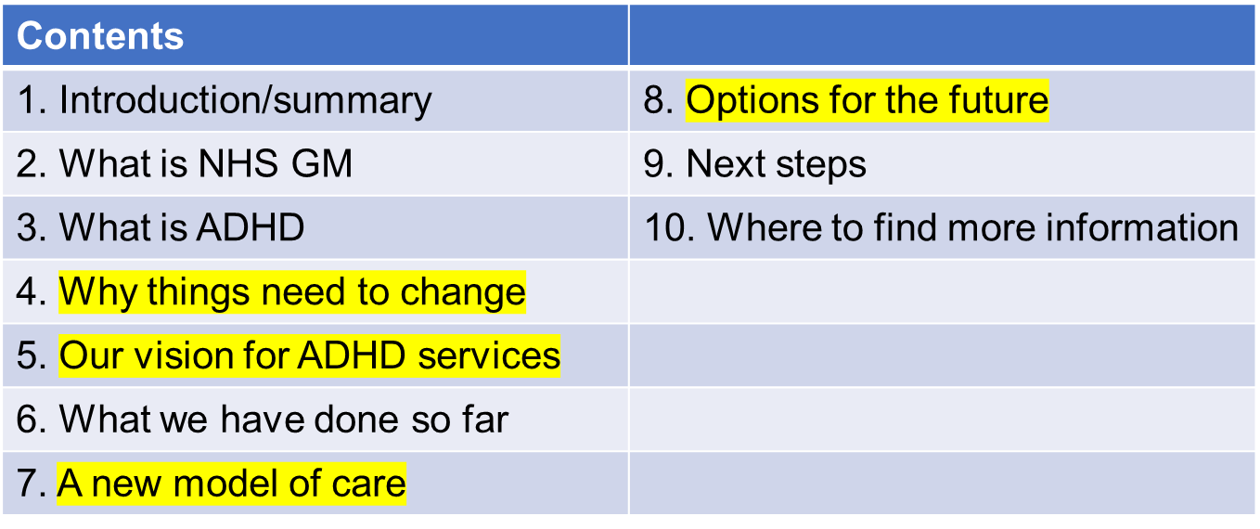
Consultation document We need your views!!
The consultation document helps gives people the information they need to get involved and give their views

Slide 9
Why things need to change: The issues
Increasing number of people coming forward and long waiting times
Financial concerns
Variation in offers across Greater Manchester
Right to choose and private providers
Safety
Support and medication

Slide 10
Contents: The Vision
We want to improve access to support, diagnostics and treatment for ADHD and we want this to be equitable and consistent across Greater Manchester.
We want a service that understands and responds to the needs of individuals and is not a ‘one size fits all’. This includes an offer of support for everyone and a diagnosis for those who need it most. We will do this by:
Prioritising access for individuals on the waiting lists who are in the most clinical need
Introducing a newly commissioned Greater Manchester Adult ADHD Triage Team of Mental Health Practitioners who would undertake face-to-face detailed assessments in support of initial GP consultations
Implementing a Triage Assessment Process model that supports GPs and patients by prioritising those patients who are most at risk and have the highest clinical need, with clear criteria for eligibility for NHS-funded assessments and treatment
Ensuring there is an appropriate support offer for people who do not meet the criteria for diagnosis but feel they would benefit from this

Slide 11
The vision continued… How this will benefit patients.
This means that people will wait less time to receive the support and treatment they need. Support will be available much earlier in the patient journey and they will not have to wait for a formal diagnosis to access it. It also means that those who need help most are prioritised for assessment and diagnosis earlier and prevent their symptoms worsening.
Who do we need to target?
Young people transitioning to adults' services, and those heading to college, university and into the workplace
Women who are pregnant and with young children
People who struggle with the cost of living and live in deprived communities
People with autism and/or other neurodiverse conditions
People with learning difficulties or learning disabilities
People with mental health conditions
People with histories of struggles with alcohol or drugs
People who are in or have experience of the criminal justice system as children or adults
Ethnic minority groups
LGBTQQIA communities

Slide 12
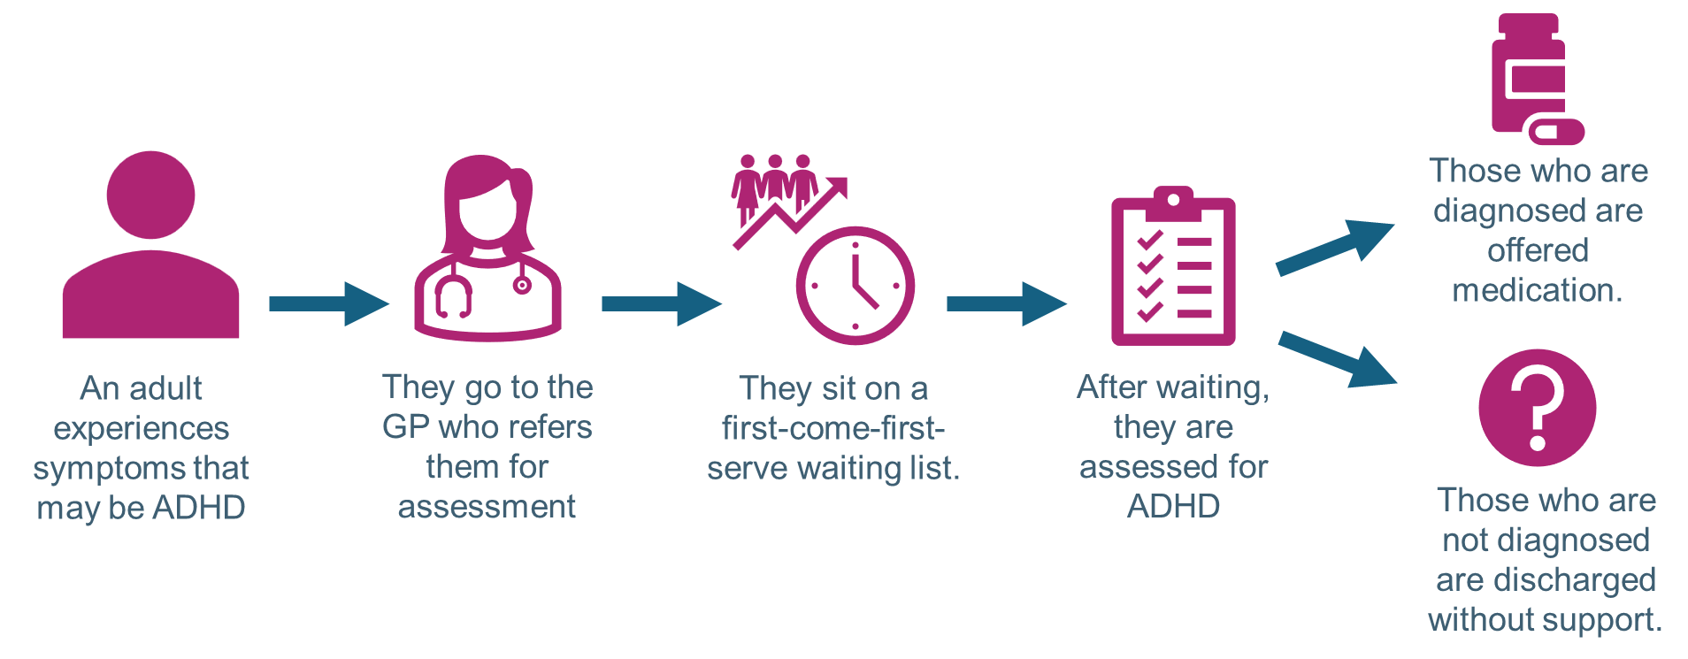
Current Service

Slide 13
The options
Chris Pimlott

Slide 14
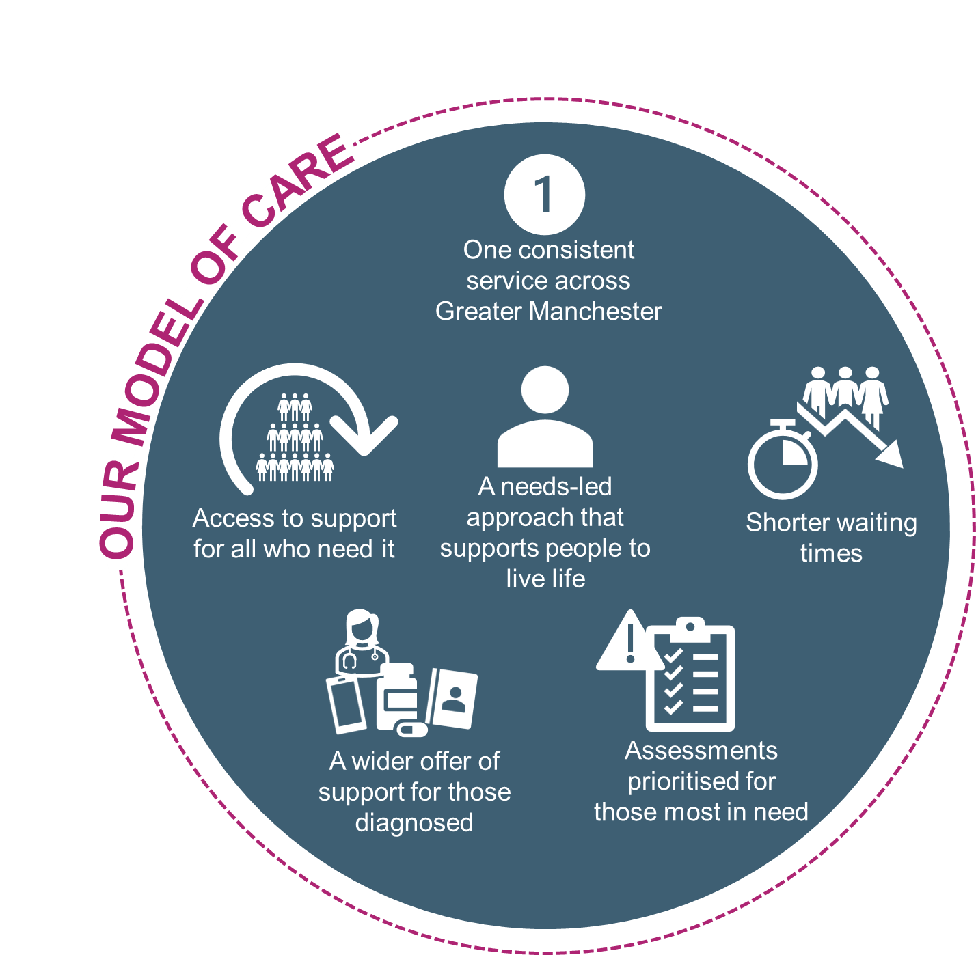
New model of care
Referral criteria
A new triage team
Treatment and support
Impact on patients

Slide 15
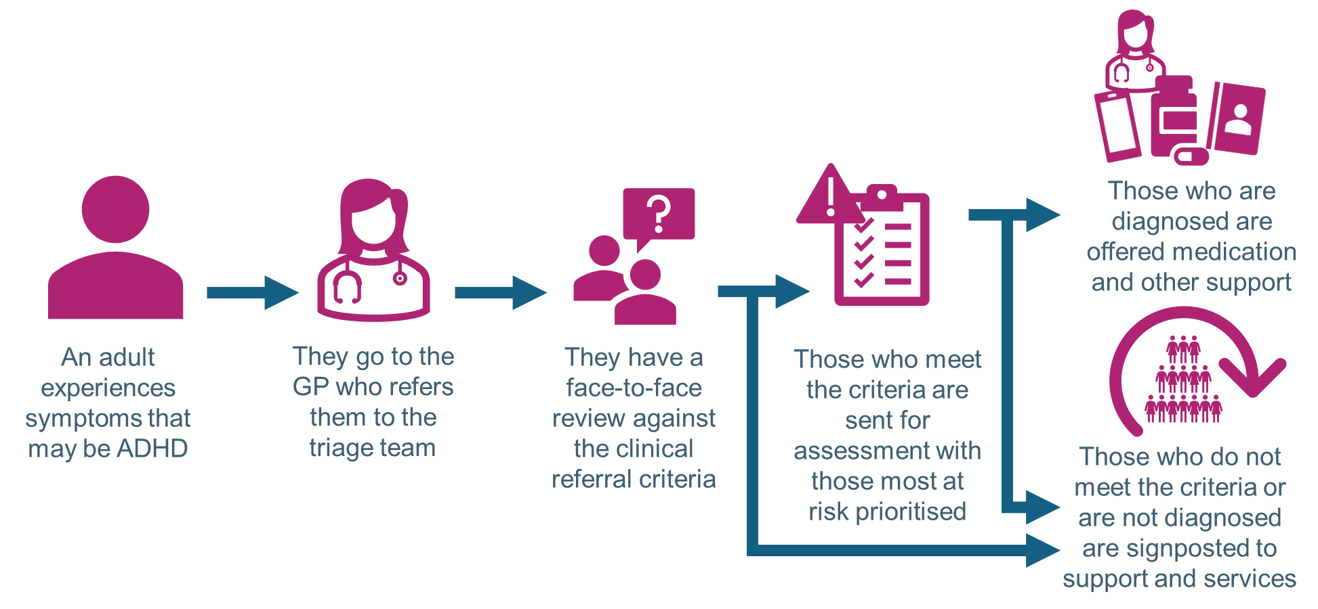
Options for change:
Option A (preferred option) A face-to-face review against referral criteria with support for everyone
This option is our preferred option for the future of adult ADHD services. This is because people who are at risk of harm will be reviewed faster in this option than in option B, meaning that they will get the help they need more quickly.

Slide 16
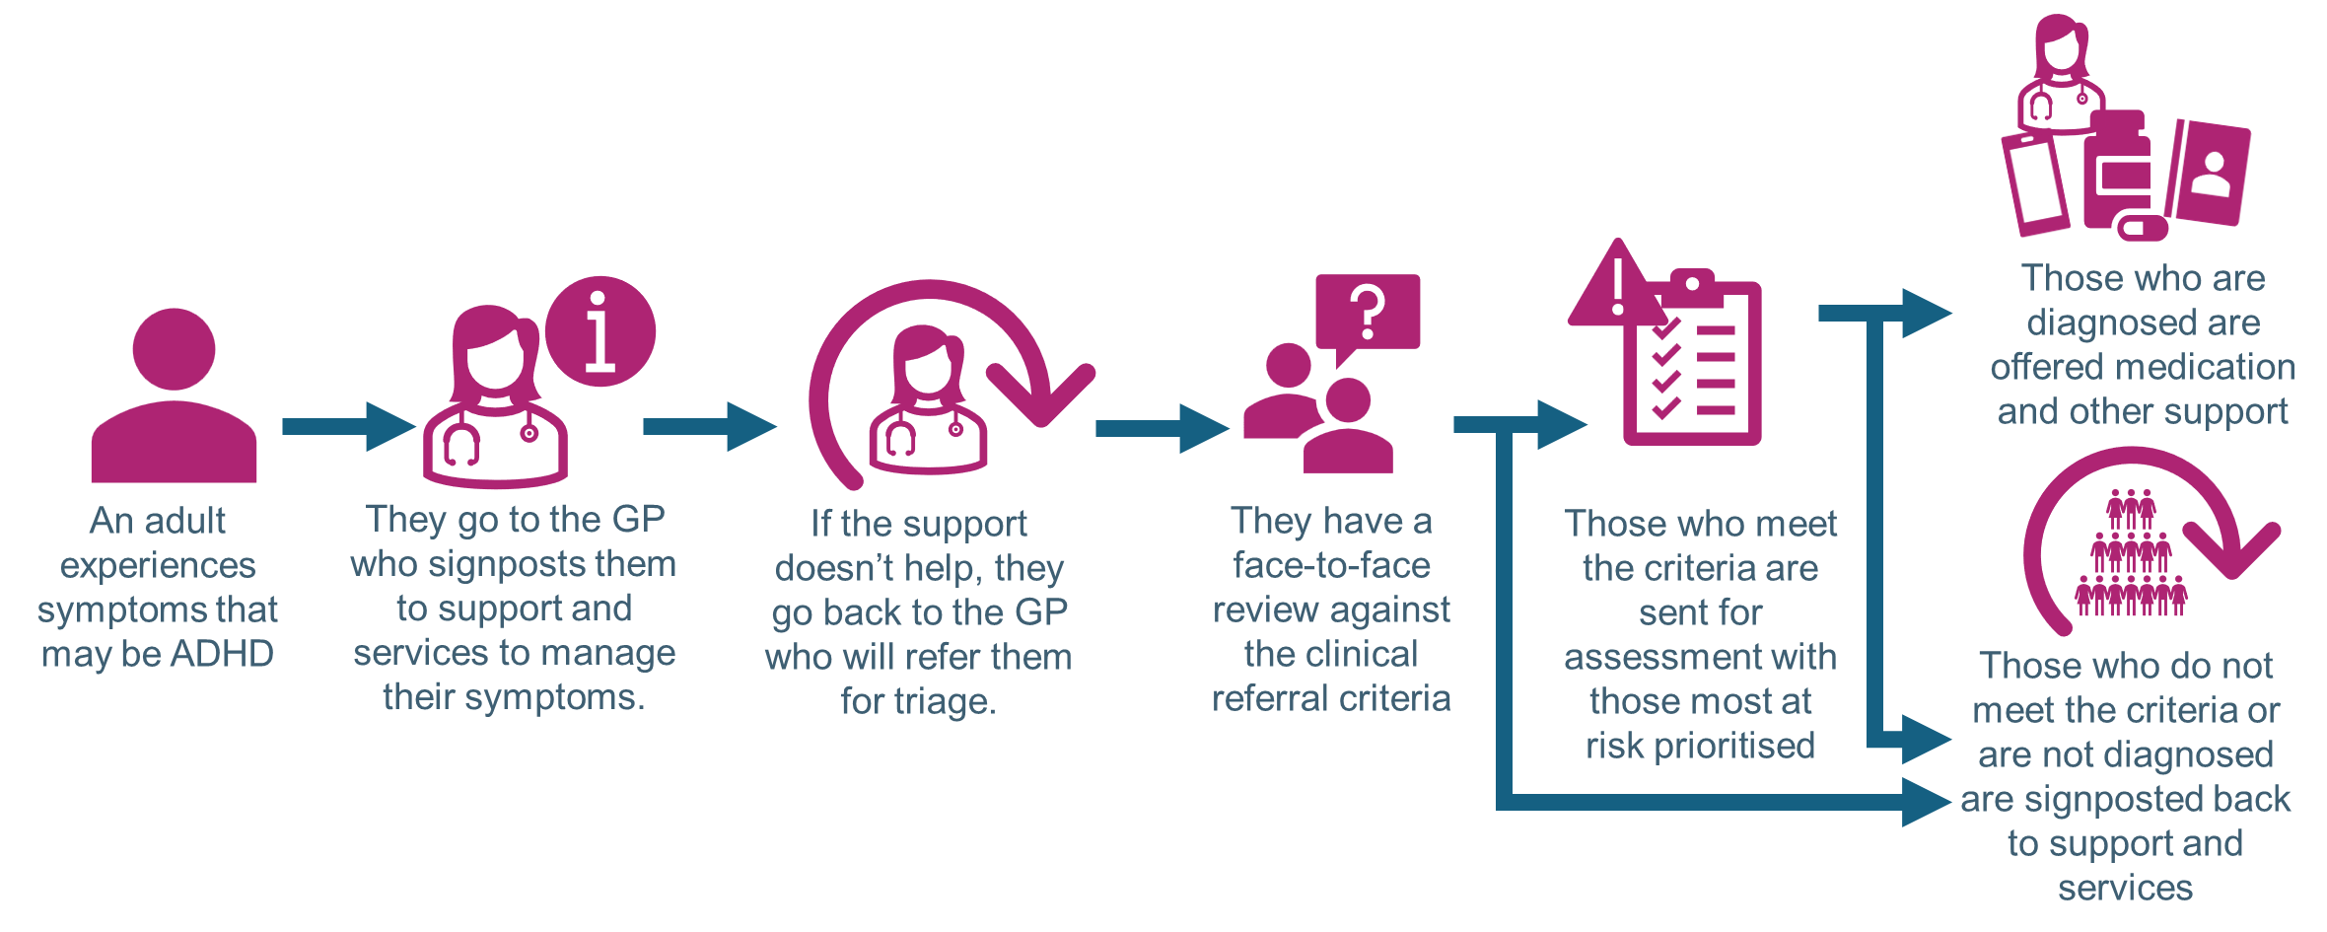
Options for change:
Option B: Support for everyone with a face-to-face review against referral criteria and triage for assessment only undertaken after the support doesn’t work

Slide 18
Discussion and feedback
Is the information clear
Is there anything you aren’t sure about?
Is there anything else people might want to know?
Any other comments?
Notes:
Open Floor for Discussion:
Allow participants to ask questions and seek clarifications.
Encourage open discussion about the pros and cons of each option.
Stakeholder Feedback:
Collect feedback and input from all key stakeholders.
Ensure all voices are heard, including any concerns or alternative viewpoints

Slide 19
Next Steps
Notes:
Action Items:
Outline the immediate next steps, responsibilities, and timelines.
Communication Plan:
Plan how the decision and its rationale will be communicated to broader stakeholders.

Slide 20
Next steps: We need your help
Develop a stakeholder list
Preparation for ‘Go Live’
Identification of key stakeholders
Survey development
Detailed engagement plan
Fortnightly LEAG meetings up to the live date

Slide 21
Existing stakeholders identified in engagement phase
Commissioners
Project Lead
Clinical Staff
Wider Staff
Task and Finish Group
LEAG
Equalities Team
NHSE
GMCA
Healthwatch
10GM
GM Equals
Primary Care and PPG’s
Manchester ADHD Steering Group (AADD)
MADDchester
LGBT Foundation
MP’s and Cllrs
Locality Participation Groups
GMMH
Pennine Care
Notes:
Has anyone else got anything to add?

Slide 22
Next meeting.
Tuesday 18th March 2025
5:45pm-6:45pm

